Slide 1


Lessons learnt:
Digital transformation led us to re-thinking of how certificates of completion are issued.
Digital credentials will transform how we interact, attain and share credentials.
Lots of challenges

Slide 2
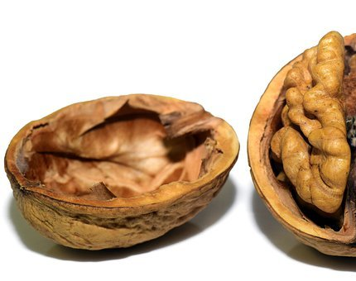
IÐAN Education Centre - Private non- profit Education and training centre.
Continues professional devolvement courses for the industry in Iceland – 300 courses – issuing around 3000 certificates per year
Validation of prior learning against National curricula in crafts and trades. Approx. 300 clients a year
Administration and organisation of Journeyman's examinations in approx. 28 different trades – around 500 qualifications qualification a year.
Enhance the image of crafts and trades
Innovation and development
24 fulltime staff

Slide 3

What happened in 2020? Disruption! Digital transformation of services.
Review on how we issue our certificates.
Can we do it better?
Research – what is going on out there (nationally and internationally)
Reaching out – we found a small innovative company that could work with us.
Everyone onboard…Trying to understand …
This is about changing culture

Slide 4

Getting to know digital
Digital Credentials, Digital badges, assessment credentials, micro credentials…
Who should get the necessary information on what are digital credentials?
  Do our users know what digital credentials are?
  Short answer NO
Two worlds?
  The reality of digital transformation!

Slide 5

- Why digital credentials – foreseen impact
A better way to capture and communicate learning
  For the learner – educator – company
  Sharable credentials
  Enhance “your” brand
  Secure, accessible and verifiable

Slide 6

Making issuing of credentials more secure
Seamless integration – LISA web-based content management system probably the smallest in the world – is now issuing digital secure encrypted credentials… and nobody knows- the difference
The challenges of “true” integration are many and only some of them digital. (human vs digial)

Slide 7

Lessons learnt:
Don’t be afraid - Don’t be alone
Be creative/ curious
Visualise (My Icelandic plumber that gets hired in Denmark – through sharing digital credentials on social media)
Understand the user (who is you’re user?)
Start, learn from mistakes and get to know your user.
Be empathetic - It is about
changing culture.

Slide 8
Some references.
https://www.researchgate.net/project/European-Innovation-Policies-for-the-Digital-Shift
https://www.researchgate.net/publication/324169662_Validation_of_the_Innovation_Radar_assessment_framework
https://www.readytech.com.au/the-digital-credentials-explosion-with-david-kinsella/
https://openbadges.org/about/
https://analytics.hbs.edu/blog/business-intelligence-vs-business-analytics/
^{https://diplomasafe.com/}
https://cpduk.co.uk/
https://suhf.se/app/uploads/2019/07/Bildning-utbildning-matchning_140513.pdf
https://www.si.is/media/_eplica-uppsetning/Menntastefna-SI-Final.pdf
https://www.ssh.is/images/stories/S%C3%B3knar%C3%A1%C3%A6tlun/Lokaskyrslur/Sk%C3%B3lar/S%C3%ADmenntun%20%C3%A1%20vinnumarka%C3%B0i-LOK.pdf
https://www.compasspoint.org/sites/default/files/documents/CompassPoint_Next%20Generation%20Orgs_2011_0.pdf
https://hbr.org/2019/07/building-the-ai-powered-organization
https://hbr.org/2020/05/the-agile-c-suite
https://www.edcircuit.com/out-of-the-box-thinking-is-so-five-minutes-ago/
https://www.mckinsey.com/business-functions/mckinsey-digital/our-insights/how-to-restart-your-stalled-digital-transformation

Slide 9

Thank you for your attention
Helen Gray
helen@idan.is
Sigurður Fjalar
sfjalar@idan.ís

